Slide 1
FSC Marketing Update
September 2020
Covering:
Social media: Organic
Social media: Paid
Email marketing
Search campaigns
Website analytics
Stay with us booking numbers
Next steps

Slide 2
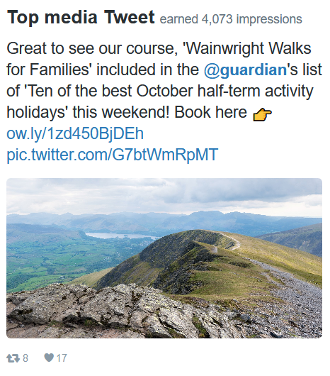
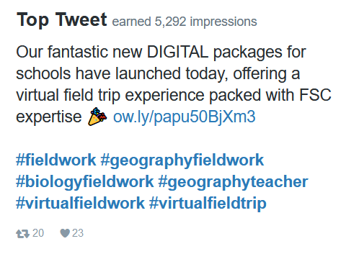
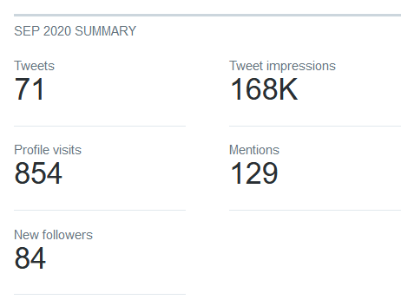
FSC Marketing Overview
September 2020
Social – Twitter
@FieldStudiesC
11,191 Twitter followers.

Slide 3
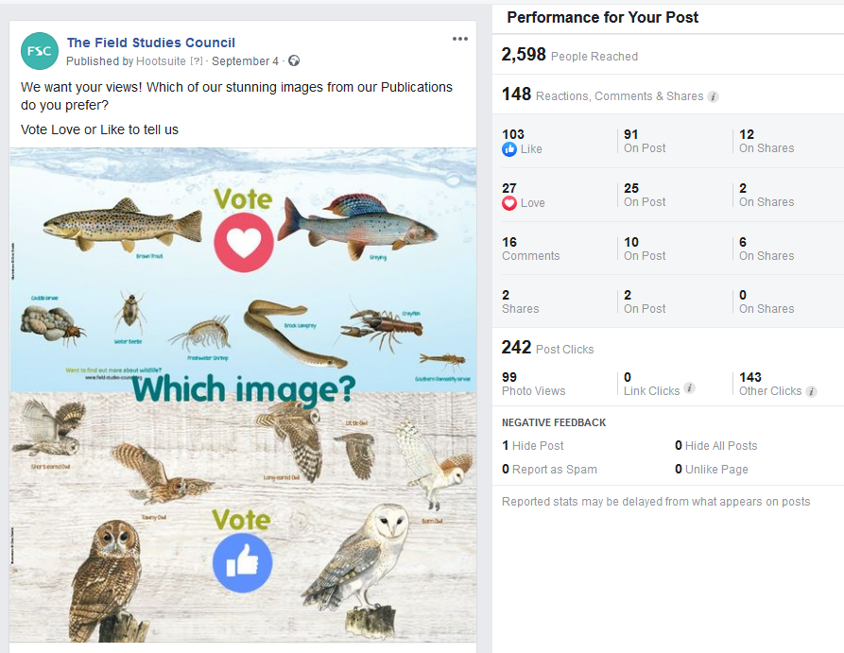
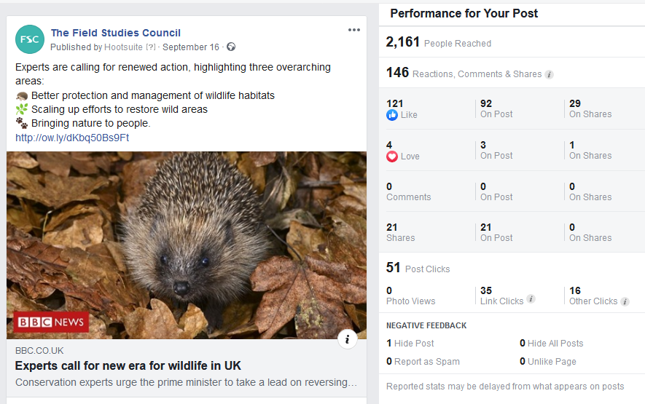
FSC Marketing Overview
September 2020
Social – Facebook
The Field Studies Council
Top Facebook posts:
2.9% engagement rate. Up 1.3% from previous month
313 likes gained = 9,593 Page likes in total.

Slide 4
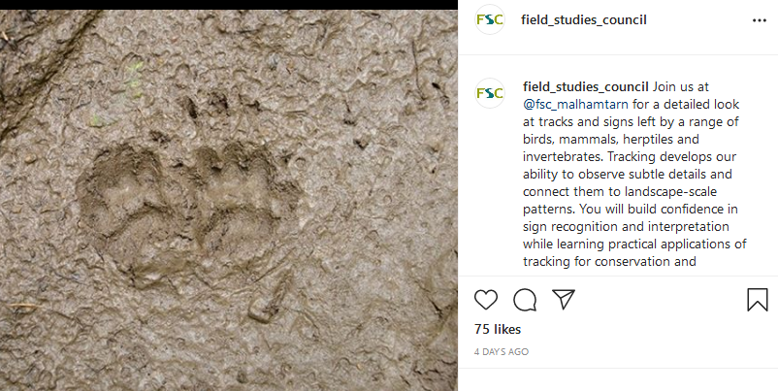
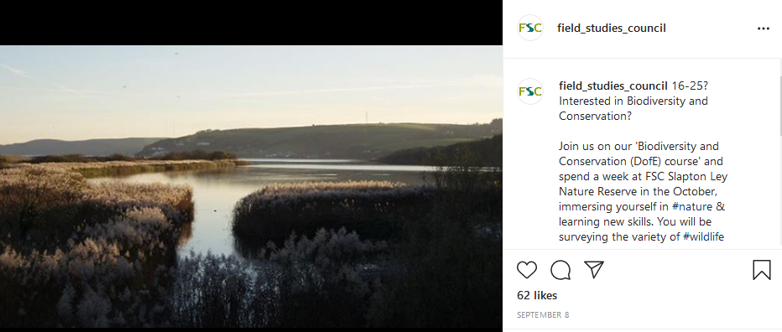
FSC Marketing Overview
September 2020
Social – Instagram
@field_studies_council
1,893 Instagram followers.

Slide 5
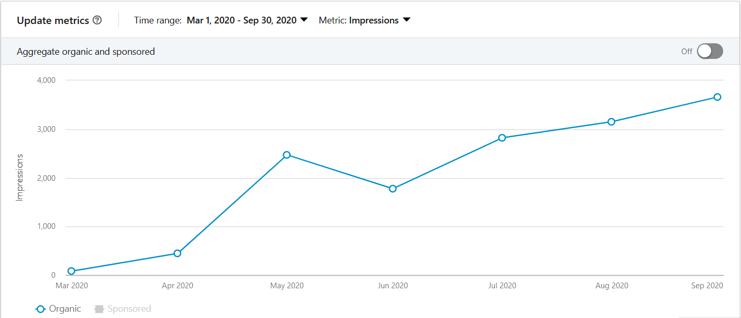
FSC Marketing Overview
September 2020
Social – LinkedIn
@field_studies_council
Since March we have started posting once a week on LinkedIn. We have 1,593 followers altogether.
112 followers gained - Up 80% on previous month

Slide 6
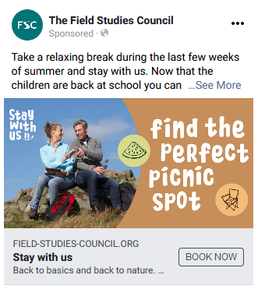
FSC Marketing Overview
September 2020
Social – Facebook: Paid
Stay With Us
Stay with us Facebook advertising in September focussed on an older audience who may have been looking to get away in the last few weeks of summer since the schools reopened. Facebook remained the top referrer for the Stay With Us webpage and accounted 45% of the pages total views in September.

Slide 7
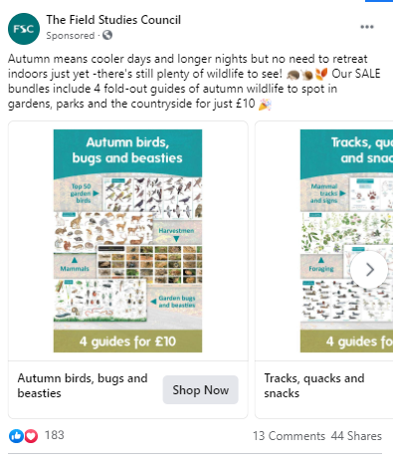
FSC Marketing Overview
September 2020
Social – Facebook: Paid
Publications
Publications launched new Autumn bundles of charts at 4 for £10 on 21st September. Facebook adverts to promote these achieved 123 sales and £3,160 income (from a spend of £396).
Time spent prior to set up on identifying and profiling different target audiences and key messaging for each.

Slide 8
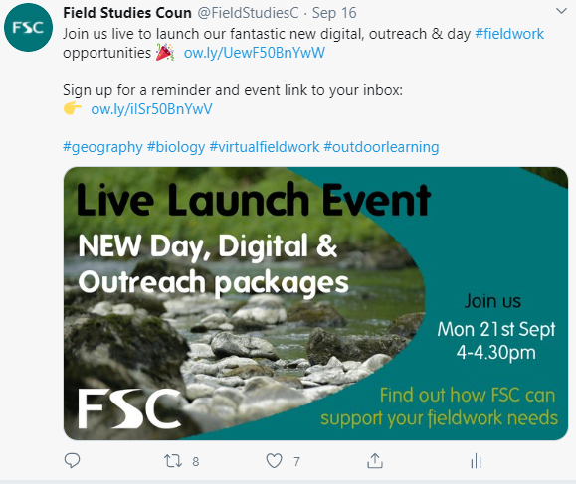
FSC Marketing Overview
September 2020
Social – Twitter: Paid
Digital, Outreach and Day Product Launch
Small campaign to promote our live YouTube launch to teachers and encourage sign ups to Mailchimp to receive information about the event/our products.
Promoted tweet received 29,000 impressions in the 6 day campaign.
128 teachers subscribed for information and the launch video is at 347 views.

Slide 9
FSC Marketing Overview
September 2020
Social – Centre Leader Board
 | Centre | Twitter Followers
1st | Blencathra | 5,531
2nd | Dale Fort | 2,550
3rd | Slapton | 1,929
4th | Epping Forest | 1,522
5th | Orielton | 1,514
 | Centre | Facebook Likes
1st | Ireland | 2,252
2nd | Millport | 1,413
3rd | Bishops Wood | 1,350
4th | Epping Forest | 1,072
5th | Margam | 1,066
 | Centre | Instagram Followers
1st | Blencathra | 708
2nd | Juniper Hall | 686
3rd | Millport | 676
4th | Ireland | 593
5th | Dale Fort | 479

Slide 10
FSC Marketing Overview
September 2020
Email
Stay With Us
Autumn Adventures Launch sent on 05.09.2020: Opened 58% | Clicked 16%
Off Peak Prices sent on 11.09.2020: Opened 27% | 5%
Live links to Autumn Adventures sent on 28.09.2020: Opened 31% | 4%
General
September Newsletter sent on 01.09.2020: Opened 33% | Clicked 7%
September Newsletter resend sent on 02.09.2020: Opened 17% | Clicked 3%
FSC Courses – Next Steps for 2021 sent on 02.09.2020: Opened 61%
Duke of Edinburgh
Email to DofE participants (sent by DofE) 28.09.2020: Opened 37% | Clicked 5.7%
Schools
Launch event: FSC Digital, Outreach and Day fieldwork packages:
To NEA conference contacts sent on 17.09.2020: Opened 40% | Clicked 20%
To #Fieldworklive CPD webinar contacts sent on 17.09.2020: Opened 55% | Clicked 6%
To #Fieldworklive webinar contacts sent on 17.09.2020: Opened 39% | Clicked 12%

Slide 11
FSC Marketing Overview
September 2020
Email
Schools continued
Launch event reminder sent on 21.09.2020 am: Opened 44% | Clicked 20%
Launch event reminder Resend 21.09.2020 pm: Opened 37% | Clicked 17%
Launch event follow up sent on 22.09.2020: Opened 42% | Clicked 14%
Sep/Dec 2019 customers not rebooked sent on 22.09.2020: Opened 28% | Clicked 5%
Schools Geography Newsletter sent on 29.09.2020: Opened 28% | Clicked 4%
Schools Biology Newsletter sent on 29.09.2020: Opened 26% | Clicked 4%
Schools via Education Company
Primary d&o email 1 sent on 09.09.2020: Warm: Opened 15% | Clicked 8% Cold: Opened 11% | Clicked 15.8%
Primary d&o Resend email 1 sent on 16.09.2020: Warm: Opened 9% | Clicked 5.5% Cold: Opened 4.4% | Clicked 19.5%
Secondary ddo email 1 sent on 09.09.2020: Warm: Opened 20% | Clicked 19% Cold: Opened 14% | Clicked 22%
Secondary ddo Resend email 1 sent 16.09.2020: Warm: Opened 9% | Clicked 9% Cold: Opened 6.5% | Clicked 7%
Primary d&o email 2 sent on 24.09.2020: Warm: Opened 14% | Clicked 10% Cold: Opened 12% | Clicked 4%
Secondary ddo email 2 sent on 23.09.2020: Warm: Opened 22% | Clicked 8.5% Cold: Opened 14% | Clicked 12%

Slide 12
FSC Marketing Overview
September 2020
Digital Agency
Keywords: Keyword rankings have fluctuated this month, but continue to perform well. The largest improvements came from "Duke of Edinburgh courses", which jumped an impressive 38 places to position 15. There are also two new keywords ranking, which is great.
Google Ad Campaigns: Google Ads saw a slight drop in clicks. However, conversions increased by 186%, with 53 generated, which is excellent. The Brand campaign recorded the largest amount of clicks, recorded the most conversions and had the highest conversion rate.
Ecommerce: Compared to last month, both the number transactions and overall revenue has seen a steady increase, with over £35,000 generated, which is excellent. Google organic traffic generated the most revenue, followed by direct traffic.

Slide 13
FSC Marketing Overview
September 2020
Website Analytics: field-studies-council.org
1st – 31st August 2020
User sessions: 52,523
School enquiry form submissions: 15
Courses purchased: 843 = £14,062
Publications purchased: 2,362 = £11,530
Checkout donations total: 392 = £1,702.68
1st – 30th September 2020
User sessions: 49,088 -7%
School enquiry form submissions: 53 +253%
Courses purchased: 2,181 = £24,205.82* +253%
Publications purchased: 1,980 = £9,588.60 -16%
Checkout donations total: 424 = £1,606.85 +8%
*Note many payments will be deposits so the actual value of sales is higher.

Slide 14
FSC Marketing Overview
September 2020
Next steps
Stay With Us
Continue to promote Autumn Adventures and come up with and promote a Christmas/New Year offer for Stay With Us
Publications
Promoting Autumn sale bundles
Launching Christmas cards and gifts
Schools
Continue to promote day, digital and outreach options via email campaigns, social campaigns, partners, website, current customers.
Prepare for when residentials are permitted. Set up content for email, social, search etc
Duke of Edinburgh
Promoting October 2020 DofE Bronze expeditions and Gold residentials via social, email and DofE
Collating 2021 offer and developing a marketing plan
Universities
Continue to promote our universities offering – emails / social / website /digital ads

