Slide 1
FSC Marketing Update
October 2020
Covering:
Social media: Organic
Social media: Paid
Email marketing
Search campaigns
Website analytics
Next steps

Slide 2
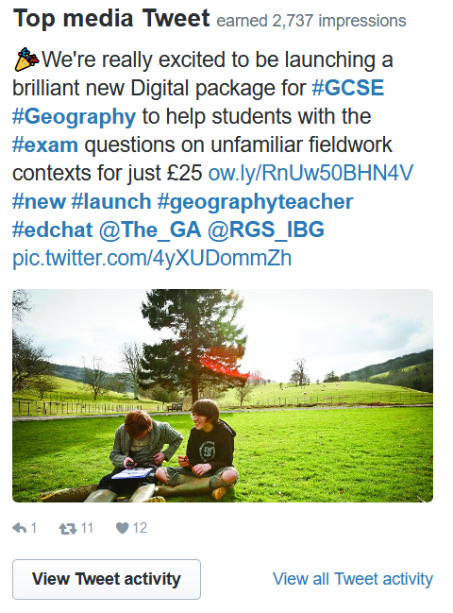
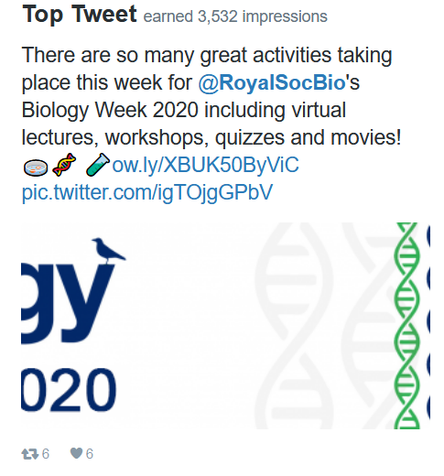
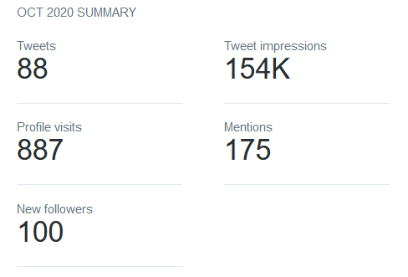
FSC Marketing Overview
October 2020
Social – Twitter
@FieldStudiesC
11,300 Twitter followers.

Slide 3
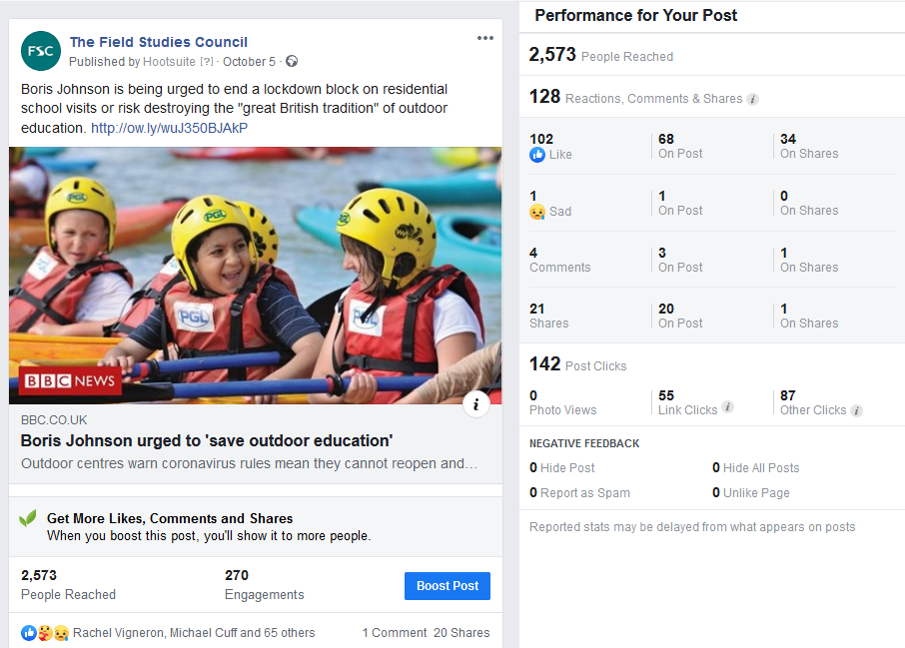
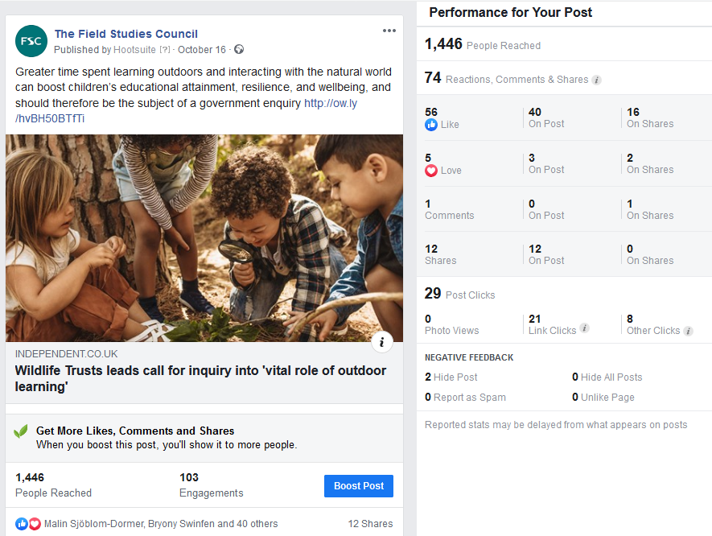
FSC Marketing Overview
October 2020
Social – Facebook
The Field Studies Council
Top Facebook posts:
610 likes gained = 10,640 Page likes in total.

Slide 4
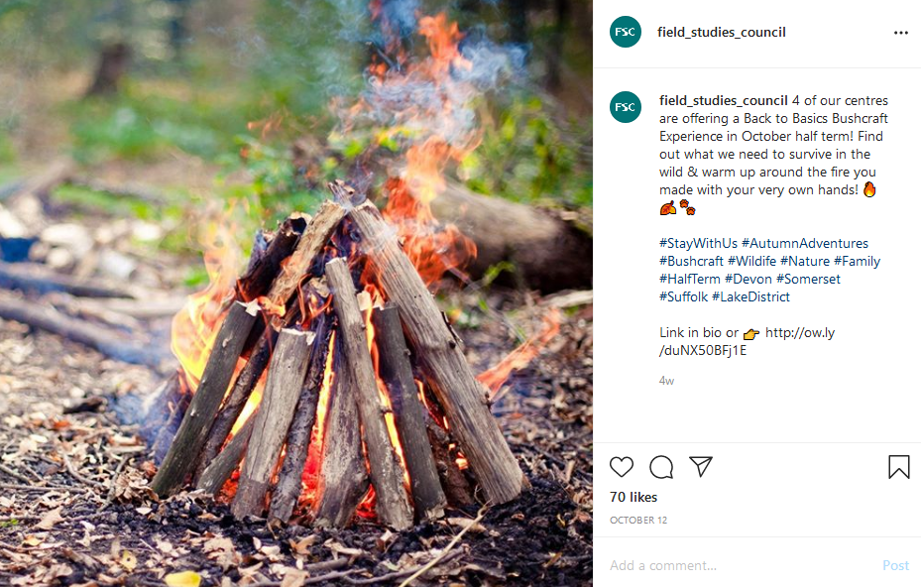
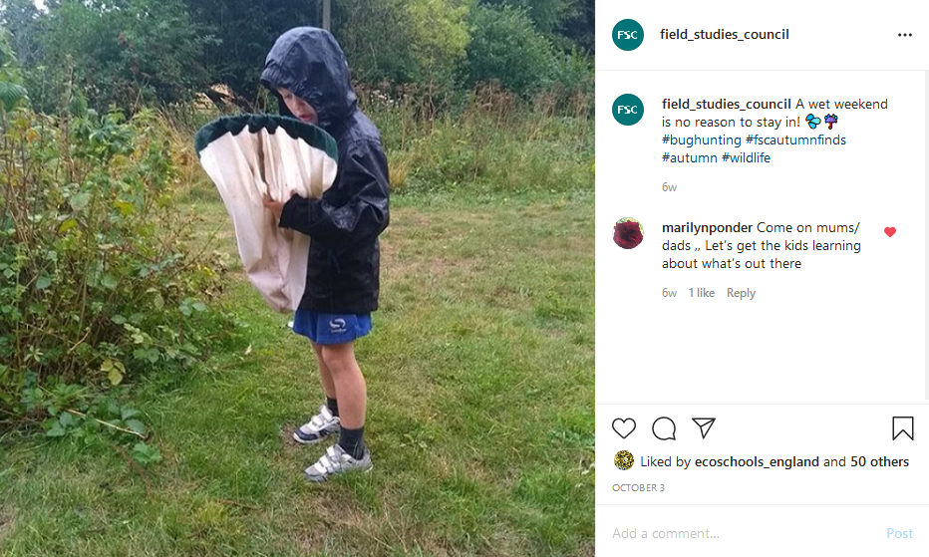
FSC Marketing Overview
October 2020
Social – Instagram
@field_studies_council
2,021 Instagram followers.

Slide 5
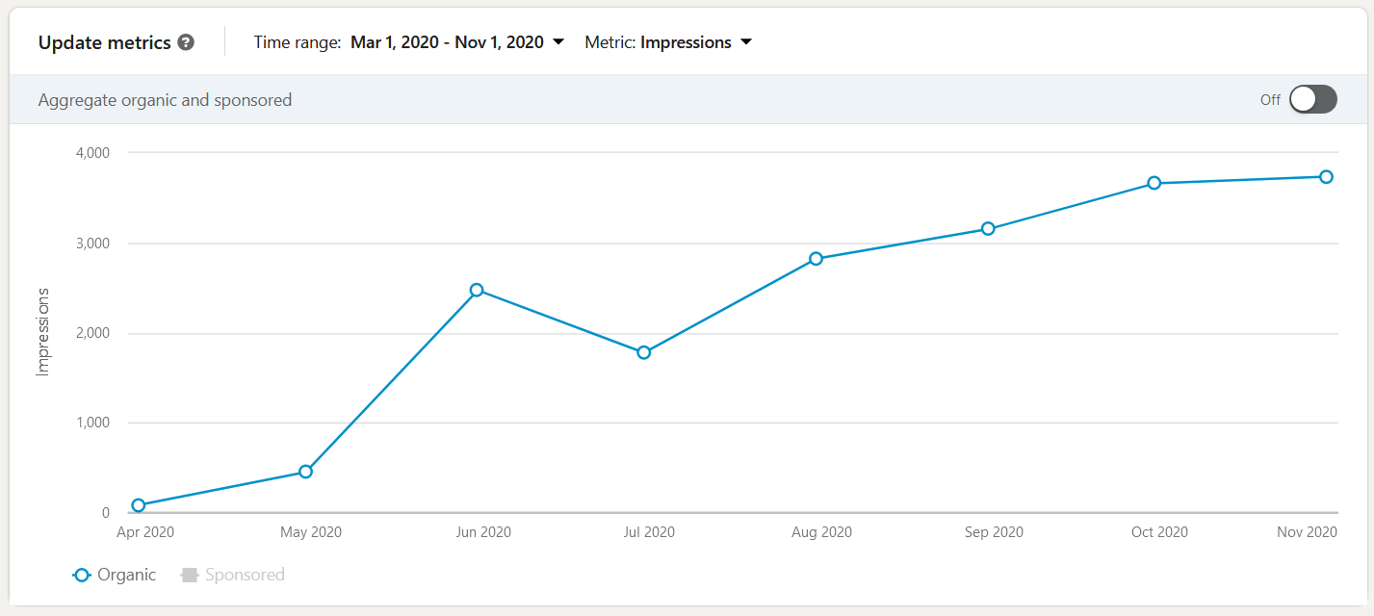
FSC Marketing Overview
October 2020
Social – LinkedIn
@field_studies_council
Since March we have started posting once a week on LinkedIn. We have 1,838 followers altogether.
112 followers gained - Up 80% on previous month

Slide 6
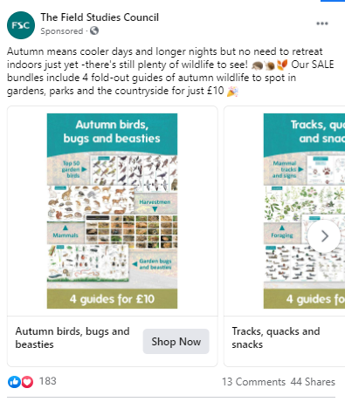
FSC Marketing Overview
October 2020
Social – Facebook: Paid
Publications
4 for £10 bundles were promoted through October with social media advertising to identified target groups and messages.
£9,500 sales were generated with Facebook advertising, which was a 350% return on investment.

Slide 7
FSC Marketing Overview
October 2020
Social – Centre Leader Board
 | Centre | Twitter Followers
1st | Blencathra | 5,546
2nd | Dale Fort | 2,552
3rd | Slapton | 1,929
4th | Epping Forest | 1,529
5th | Orielton | 1,510
 | Centre | Facebook Likes
1st | Ireland | 2,271
2nd | Millport | 1,440
3rd | Bishops Wood | 1,357
4th | Epping Forest | 1,080
5th | Margam | 1,066
 | Centre | Instagram Followers
1st | Blencathra | 720
2nd | Millport | 691
3rd | Juniper Hall | 687
4th | Ireland | 602
5th | Dale Fort | 493
Millport has moved above Juniper Hall this month!

Slide 8
FSC Marketing Overview
October 2020
Email
Stay with us
Autumn Adventures links sent on 13.10.2020: Opened 58% | Clicked 18%
Autumn Adventures links sent on 19.10.2020: Opened 29% | Clicked 2%
Holiday offer survey link sent on 13.10.2020: Opened 37% | Clicked 7%
General
October Newsletter sent on 02.10.2020: Opened 39% | Clicked 9%
Amazon smile sent on 15.10.2020: Opened 30% | Clicked 2%
Amazon smile to members sent on 15.10.2020: Opened 48% | Clicked 4%
Duke of Edinburgh
DofE October 2020 opportunities 07.10.2020: Opened 29% | Clicked 3%

Slide 9
FSC Marketing Overview
October 2020
Email
Schools
Sep-Dec 2019 customers not rebooked resend to those not opened sent on 14.10.2020: Opened 9% | Clicked 2%
Day, outreach products primary sent on 12.10.2020: Opened 10%
Day digital outreach products sent on 12.10.2020: Opened 40%
Day digital outreach products sent on 12.10.2020: Opened 35% | Clicked 9%
Day digital outreach products sent on 13.10.2020: Opened 43%
Day digital outreach products sent on 13.10.2020: Opened 34% | Clicked 9%
Day digital outreach products primary & secondary sent on 14.10.2020: Opened 20% | Clicked 2%
Schools via Education Company
Primary d&o email 3 sent on 15.10.2020: Warm: Opened 11% | Clicked 9% Cold: Opened 9.5% | Clicked 4.5%
Resend Primary d&o email 3 sent on 21.10.2020: Warm: Opened 6% | Clicked 10% Cold: Opened 9.5% | Clicked 6%
Secondary ddo email 3 sent on 06.10.2020: Warm: Opened 21% | Clicked 7.5% Cold: Opened 16% | Clicked 3%
Resend Secondary ddo email 3 sent 13.10.2020: Warm: Opened 6.4% | Clicked 9% Cold: Opened 5% | Clicked 3.7%
Secondary digital promotion sent 13.10.2020: Opened 19% | Clicked 15%
Resend Secondary digital promotion sent 13.10.2020: Opened 7% | Clicked 10%

Slide 10
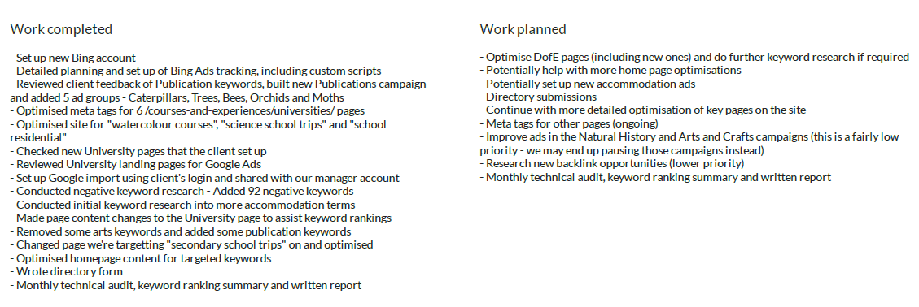
FSC Marketing Overview
October 2020
Digital Agency
Keywords: Keyword rankings have fluctuated this month, but continue to perform well. The biggest improvement comes from "summer camps uk", which jumped 13 places to position 28. There are also 20 new keywords ranking, including “field centres" which is sitting at the top of page one on Google.
Google Ad Campaigns: Compared to September, Google Ads has seen a slight increase in clicks. However, conversions have dropped, with just under 25 recorded. The majority of these conversions
were transactions, followed by email address clicks.
Ecommerce: Compared to last month, both the number of transactions and overall revenue saw a slight decrease, with just over £29,000 generated.

Slide 11
FSC Marketing Overview
October 2020
Website Analytics: field-studies-council.org
1st – 30th September 2020
User sessions: 49,088
School enquiry form submissions: 53
Courses purchased: 2,181 = £24,205.82
Publications purchased: 1,980 = £9,588.60
Checkout donations total: 424 = £1,606.85
1st – 31st October 2020
User sessions: 45,540 -8%
School enquiry form submissions: 44 -20%
Courses purchased: 1,172 = £13,513* -86%
Publications purchased: 2,500 = £13,705 +26%
Checkout donations total: 418 = £1,353.25 -1%
*Note many payments will be deposits so the actual value of sales is higher.

Slide 12
FSC Marketing Overview
October 2020
Next steps
Stay With Us
Come up with and promote a Christmas/New Year experiences
FSC Holiday Offer
Design programme for Family Activity Holidays for 2021 in preparation to launch on boxing day
Publications
Promoting AIDGAP sale
Promoting Christmas cards and gifts
Schools
Continue to promote day, digital and outreach options. Streamlining digital purchase process.
Prepare for when residentials are permitted. Set up content for email, website, print, social, search etc.
Duke of Edinburgh/16+
Collating 2021 offer, getting onto the website and developing a marketing plan
Google My Business pages
Do a complete review of all centre pages on google and update information where required to ensure correct information is displayed and consistency.

